Slide 1






Machine learning
Cours 3 :Classification
David Rousseau

Slide 2
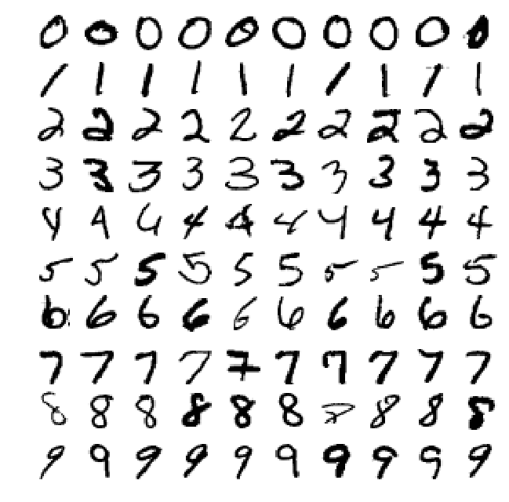
Character classification
We work on the MNIST data base: 70000 images of hand written figures

Slide 3
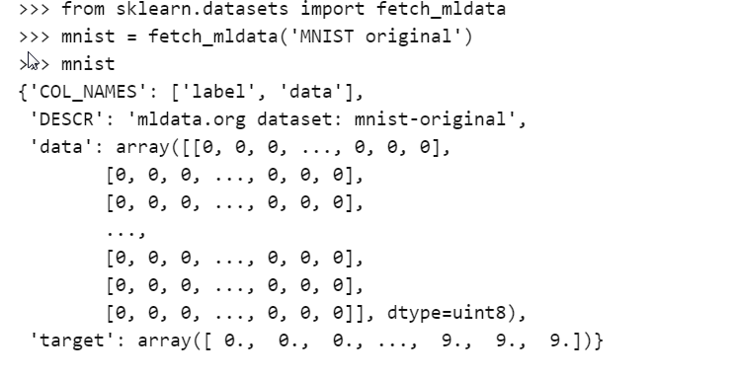
Fetch the data
Data sets loaded by Scikit-learn generally have a similat dictionary structure including:
DESCR key describing the dataset
Data key containing an array with 1 row perinstance and 1 column per feature
Target key containing an array with the labels

Slide 4
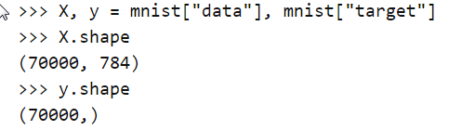
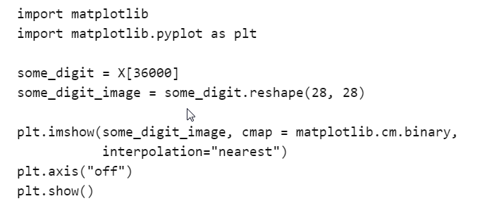

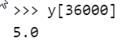
Understand data structure
70 000 images each has 784 features
Images are actually 28 by 28 pixels
Each feature represents 1 pixel’s intensity from 0 (white) to 255 (black)

Slide 5
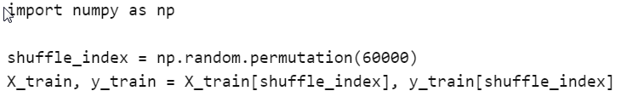
Create test/train sample
You need to shuffle the data randomly

Slide 6
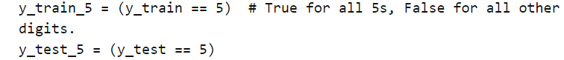
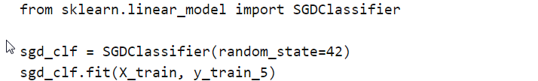
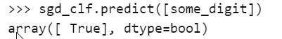
A first simple binary classifier
Let’s make a classifier that only detect if we have a 5 or something else
We select a classical classifier (Stochastic Gradient Descent)
Let’s apply it on a single digit

Slide 7
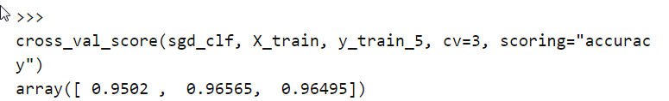
Performance metrics
Different ways of evaluating the performance of a classifier
Cross-validation
Excellent results but remember that 1 number out of 10 is a 5…
A classifier which decide everytime that a figure is not a 5 is correct 90% of the time

Slide 8
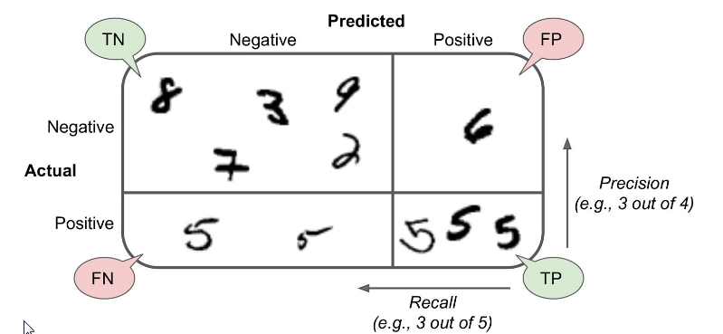
Performance metrics
There are differents ways of quantifying the performance of a classifier
Confusion matrix

Slide 9
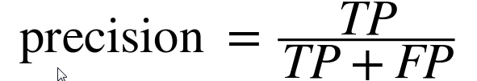
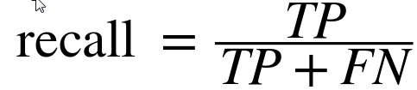
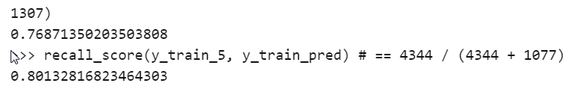
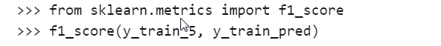
Precision and recall
Possible to combine information in the confusion matrix

Slide 10
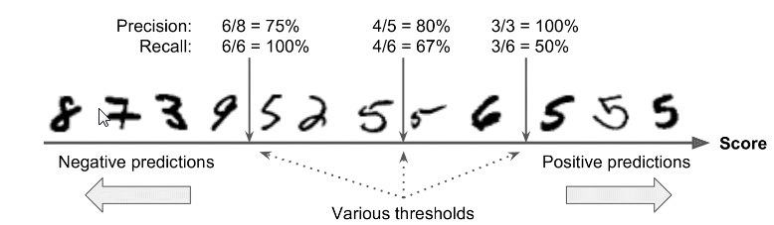
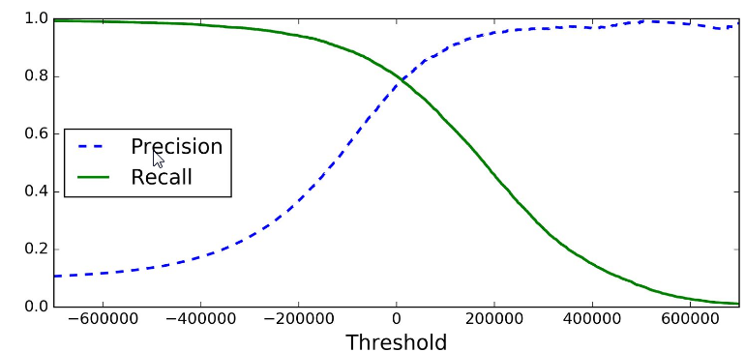
Precision recall tradeoff
If someone asks for a 99% precision you should ask for which recall

Slide 11
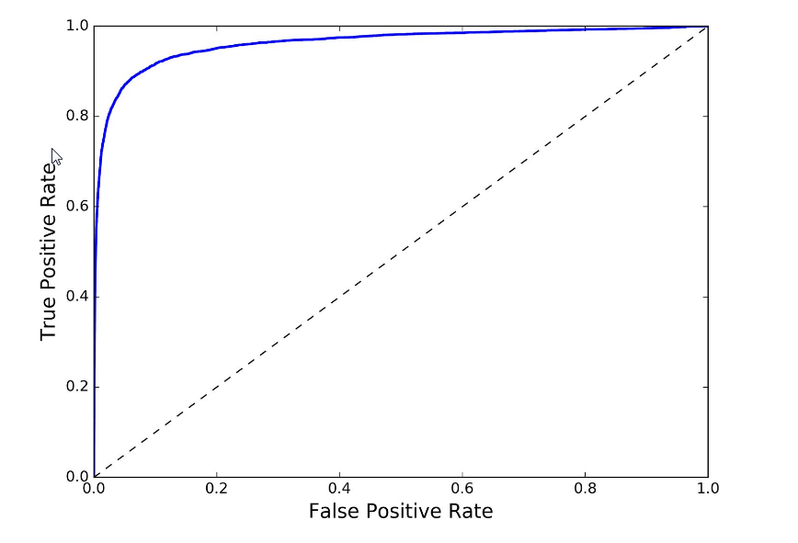
ROC Curve
Receiving operator curv
TPR=TP/(TP+FP)=Precision
FPR=FP/(FP+TN)
Quality of a classifier : Area Under the ROC curve (AUC)
AUCI Ideally =1
Prefer PR curve when the positiv class is rare or when you care more about the false positives than the false negatives and the ROC curve otherwise

Slide 12
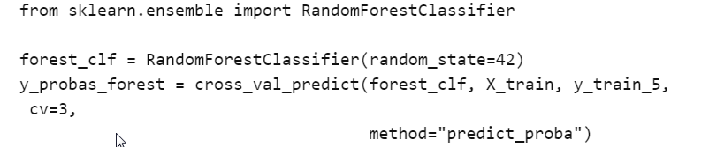
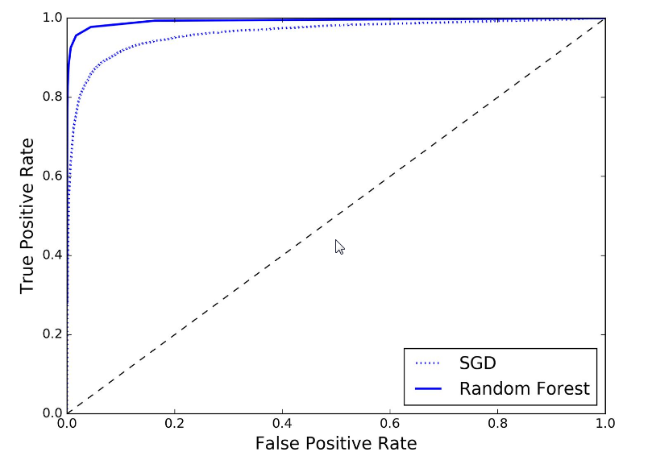
Compare two classifiers
Load another classifier for illustration
AUC SGD : 0.96
AUC RFC : 0.99

Slide 13
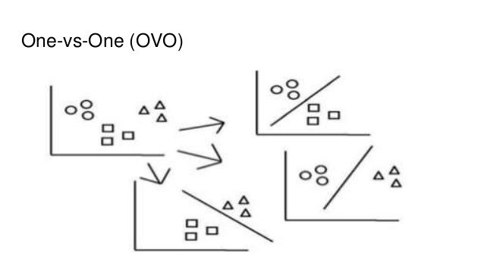
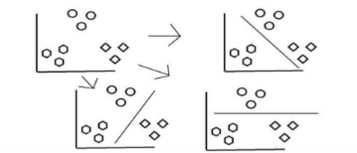
Multiclass classification
Some classifier are natively capable of realizing multiclass classification
(Random Forest, naives Bayes Classifier, …)
Other are only realizing binary classification (SVM, linear classifier, …)
There are however strategies to realize multiclass classification from the combination of binary classification
One vs All
Classify in the class which wins the more duels
Classify in the class which gives the highest score (distance to hyperplan)

Slide 14
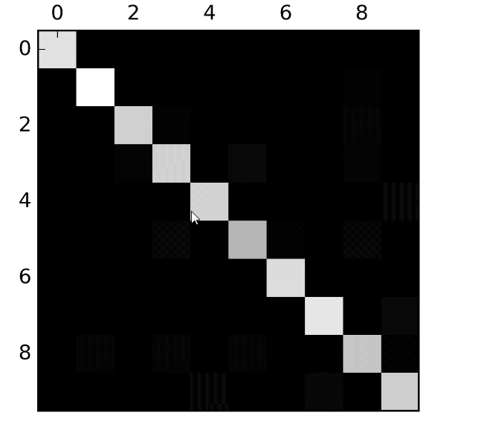
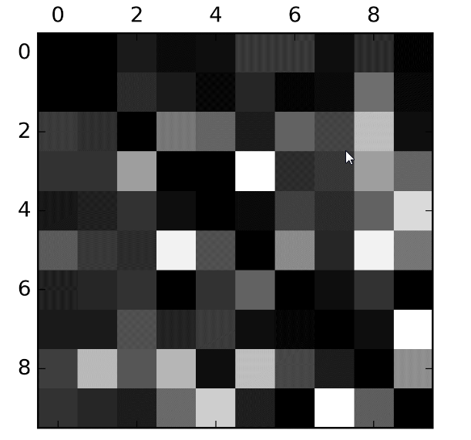
Error analysis
When multiple classes difficult to analyze the confusion matrix beause the are tow many figures
Better to observe the confusion matrix
Same with zeros in diagonal

Slide 15
Hands on

Slide 16
Next course
Clustering
David Rousseau

